Slide 1


Santosh Kumar Kar
skkar.2k2@gmail.com

Slide 2

CHAPTER – 9
Hystrix
Santosh Kumar Kar,
skkar.2k2@gmail.com

Slide 3
Client-side Circuit Breaker

Slide 4
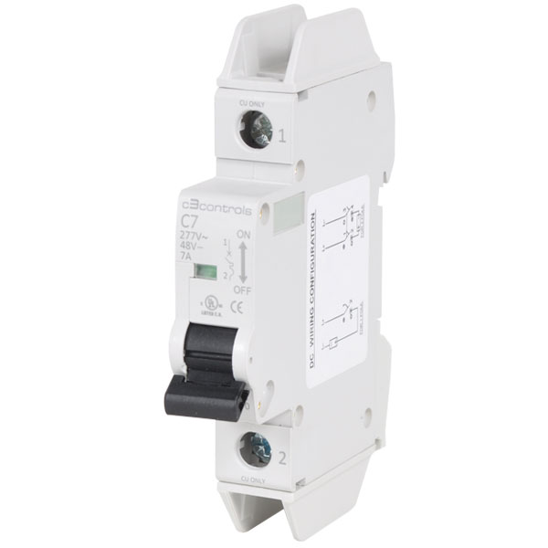
Circuit Breaker
A circuit breaker is an automatically operated electrical switch designed to protect an electrical circuit from damage caused by excess current from an overload or short circuit.
Its basic function is to interrupt current flow after a fault is detected. Unlike a fuse, which operates once and then must be replaced, a circuit breaker can be reset (either manually or automatically) to resume normal operation.

Slide 5
What Is Hystrix For?
Hystrix is designed to do the following:
Give protection from and control over latency and failure from dependencies accessed (typically over the network) via third-party client libraries.
Stop cascading failures in a complex distributed system.
Fail fast and rapidly recover.
Fallback and gracefully degrade when possible.
Enable near real-time monitoring, alerting, and operational control.

Slide 6
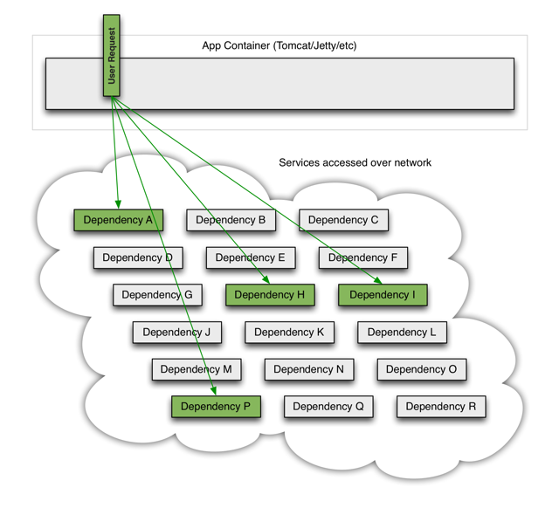
When everything is healthy the request flow can look like:

Slide 7
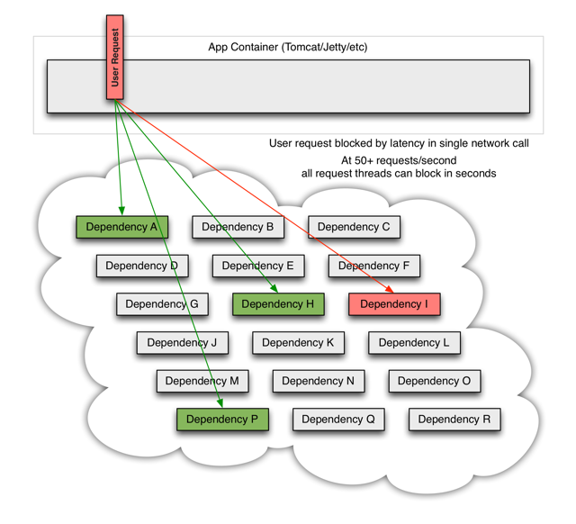
When one of many backend systems becomes latent it can block the entire user request:

Slide 8
Hystrix works by:
Preventing any single dependency from using up all container (such as Tomcat) user threads.
Shedding load and failing fast instead of queueing.
Providing fallbacks wherever feasible to protect users from failure.
Using isolation techniques (such as bulkhead, swimlane, and circuit breaker patterns) to limit the impact of any one dependency.
Optimizing for time-to-discovery through near real-time metrics, monitoring, and alerting
Optimizing for time-to-recovery by means of low latency propagation of configuration changes and support for dynamic property changes in most aspects of Hystrix, which allows you to make real-time operational modifications with low latency feedback loops.
Protecting against failures in the entire dependency client execution, not just in the network traffic.

Slide 9
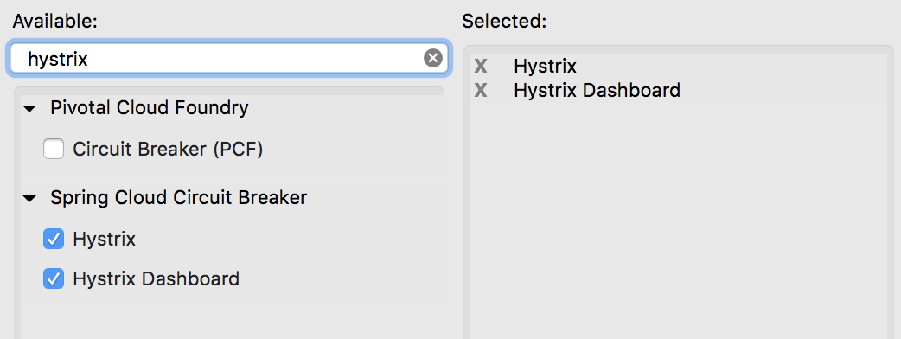
Add Hystrix Dependencies

Slide 10
@EnableHystrix in Application class
@SpringBootApplication @EnableFeignClients @EnableHystrix @EnableHystrixDashboard public class CircuitBreakerWithHystrixApplication { public static void main(String[] args) { SpringApplication.run(CircuitBreakerWithHystrixApplication.class, args); } }

Slide 11
@HystrixCommand with fallback method
@HystrixCommand(fallbackMethod = "employeeServiceFailure_Fallback") public Employee readEmpFromEmpFeignClient(@PathVariable("id") long empId) { return employeeFeignClient.getEmployeeById(empId); }
Parameter and return type should match
@SuppressWarnings("unused") private Employee employeeServiceFailure_Fallback(long empId) { System.out.println("Employee Service is down!!! fallback route enabled..."); return new Employee(); }

Slide 12
In case there is any issue with the client, the fallback method will be called.
Once the service is up, it will call as usual without falling in the fallback method.

Slide 13

Questions
Send to skkar.2k2@gmail.com

